Slide 1
Programming
Tony Nicol

Slide 2
Programming An introduction to programming in JavaScript

Slide 3
What is programming?
Giving a computer a precise, step‑by‑step set of instructions
Automating tasks that would be slow or impossible for humans
Turning ideas into repeatable, reliable processes
Using logic to solve problems systematically
Computational thinking
Breaking big problems into smaller, manageable parts
Identifying patterns and repeated steps
Designing clear, logical sequences of actions
Thinking in terms of inputs → processing → outputs
Understanding that computers do exactly what you tell them, not what you meant (ignore AI for now)

Slide 4
Make Tea
Algorithms
A structured set of steps to solve a problem
Can be written in English, diagrams, or code
Focus on clarity, efficiency, and correctness. E.g., consider explaining to a child how to make a cup of tea
Keep it relatively high level. e.g. assume that if you say "fill the kettle with water" a child could do that, but when implementing, even that would need to be addressed as it's not as simple as it sounds
Exercise
5 minutes to create a flow chart or psudo code for a times table application. i.e. a multiplier, a multiplicand and the number of results required. e.g. five times table
Output: 1x5=5 2x5=10 etc for a requested number of outputs
This is not a program coding exercise - no code required, it is a problem-solving, computational-thinking exercise
Fill kettle with water
No
Milk?
Switch kettle on
Yes
Add milk
No
Water boiling?
Yes
Sugar?
No
Put tea bag in cup
Yes
Add water to cup
Add sugar
maxDunks=3, dunks = 0
Serve tea
No
Another cup?
Yes
dunks<maxDunks?
Yes
No
Dunk bag
Finished
Increment dunks

Slide 5
Simple use case
Tables
Generate a times table of the specified multiplicand (table value), and incrementing multiplier starting at 1
e.g. Output:
1 x 5 = 5 2 x 5 = 10 … 12 x 5 = 60 In this case, the multiplicand is 5 and multiplier max is 12
P-code: Initialise the multiplicand (table value) and the maximum number of outputs. Start with a multiplier of 1. From this multiplier up to the maximum number of outputs, repeat: Output: multiplier × multiplicand = product. Move to a new line. Increase the multiplier by 1. Continue until the multiplier is greater than the maximum number of outputs.
Set table value
Set max count
Set count = 1
No
count <= maxCount
Yes
Output count * table
Increment count
Finished

Slide 6
IDE
An integrated development environment is a tool to help write, debug and test code in one place
Visual Studio Code
Supports many different programming languages
Free general purpose extensible lightweight IDE from Microsoft
Very popular for JavaScript
PyCharm
Full featured IDE for Python from JetBrains
Free community or paid professional versions
Eclipse
Mainly for Java development, free from the Eclipse foundation
InteliJ
Mainly for Java development, free community edition or paid professional from JetBrains
Netbeans
Mainly Java and web development, free from the Apache Software Foundation
Visual Studio
Multiple languages, mainly C, C++, C#, Web apps
Heavy duty IDE from Microsoft
Free community and paid professional / enterprise version
/demos/languages
Notes:
Discussed algorithm, source code, interpreter or compiler and machine code
Let's have a demo of these things
Show javascript loop formatted to more easily see debugging
Show what happens in python if the spacing is wrong

Slide 7
Pre requisites for JavaScript coding
From self service
Install visual studio code
Install nodejs
Create a git lab account if you don't have one
Context
JavaScript is an interpreted language
Browser provides a runtime environment
Node.js is a JavaScript runtime environment outside the browser
Chromium (from Google) is an open source web browser and runtime. Others build their products on top of it
Chromium-based browsers and NodeJS use the highly optimised Google V8 runtime engine with JIT compiler
Chromium-based browsers include: Chrome, Edge, Opera, Brave (not firefox or safari)
Notes:
Configure git from command line if necessary:
git config --global user.name your-user-name (--global for all repos)
git config --global user.email your-email-address

Slide 8
JavaScript
Makes web pages responsive – i.e. we can carry out computation and interact with the page to change how it looks
Designed for browsers but available for the back end (server side) application development too
A variable is a named memory space that can be assigned data. i.e., a name that refers to a value that can be changed let variableName=3 // camel case - and this is a comment variableName = variableName +5 // The memory location associated with the variable now stores 8
To declare something that cannot be changed, use const and snake_case & capitals (exceptions discussed later) const PI=3.14159 const NUM_DAYS_IN_WEEK=7
Trying to later change NUM_DAYS_IN_WEEK = 6 // will result in an error
Semicolons separate statements but are optional when it is clear to the parser where they would be e.g., let x=3 x=x+5 or let x=3; x=x+5;
let x=3 x=x+5 would be illegal. A semicolon is needed after let x=3. let x=3; x=x+5
You may see var. We don't use that anymore. Use let or const
Notes:
Demo in VScode

Slide 9
Types
There are types, but you don't need to explicitly state what they are when you declare variables and constants
JavaScript is loosely (weakly) typed and dynamically typed. Basically, variable types can change when needed to
Boolean: true or false
Null: can only have one value which is null
Undefined: a variable which has not yet been assigned a value is of type “undefined”. e.g. let x; Then assign it later
Number: this is a 64 bit floating point number – i.e., for storing real numbers such as 3.5
There is no integer type in JavaScript but number type will hold integers up to ±(2⁵³-1) accurately
BigInt: this is used for big integers such as those used in security algorithms but generally use number
NaN: Not a number. e.g. 6/”hello”
String: this is a collection of characters e.g. 'Jim'. A string is immutable – i.e. once declared it can’t be changed The first character is at position 0. You can however do things like let name='Jim'; name = name + 'smith' will in the background, create a new variable with the whole name
Object: this is a complex type which can contain properties, functions or both
If you really need to know the type of a data item, you only have to ask: the typeof operator will evaluate to the type let x=5; typeof x; will evaluate to "number"
/basics/types.js

Slide 10
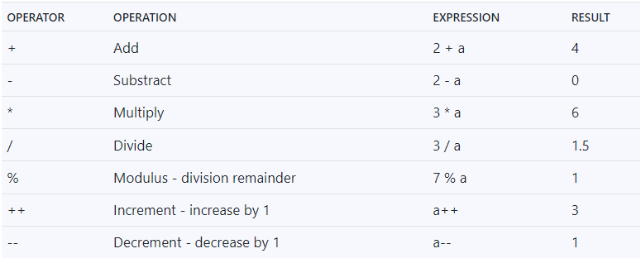
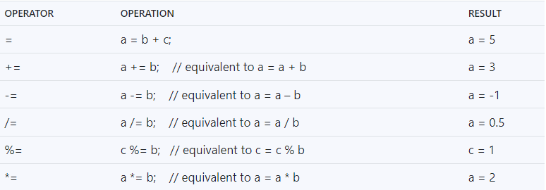
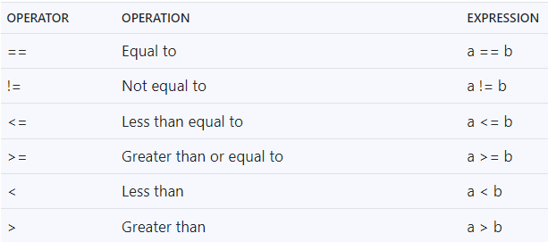
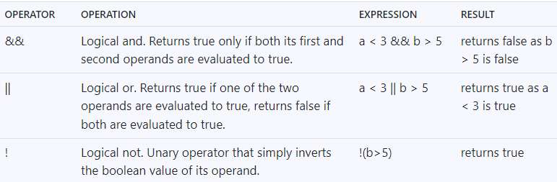
Some operators
after type coercion
=
without coercion - checks type too
=

Slide 11
Running some examples
The key programming constructs are
Sequence - one statement follows another
Selection - different path taken based on the logical outcome of a question. e.g., if one value is less than another then execute code x, otherwise execute code y
Iteration - repeat code execution over and over until a condition is met. e.g., execute the following code 10 times
Functions - if we are duplicating lines of code, put it to one side, give it a name then reference it by name
Or if you want to modularise and simplify by moving complexity elsewhere
Input / Output - we won't use input as that will eventually be a web page or API. For now we will just use output to the debug console to see what is happening but eventually output is data returned from the server
We will use files for input and output at some point
Notes:
If gitlab unavailable, copy code into teams chat

Slide 12
Selection
if (expression evaluates to true) execute
this statement
else
execute this statement
if (expression evaluates to true) {
execute this statement
and this one
}
else {
execute this one
and this one
}
/demos/basics/if.js
Notes:
Imperative programming key constructs are: Sequence, Selection and Iteration
Illustrate debugger on statements
Note: numeric 0 evaluates to true and any other number to false so this feature can be used in logical statements

Slide 13
else if
For more test cases you can use multiple if, else if
if (expression evaluates to true) { execute this block } else if (expression evaluates to true) { execute this one } else if(expression evaluates to true) { execute this one } else { this one }

Slide 14
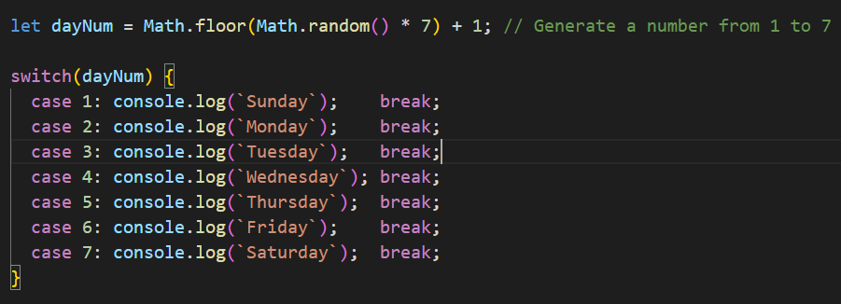
Switch
Like multiple if / else but neater in many cases
JavaScript will match on anything - it's just a lookup
/demos/basics/switch.js
Notes:
Explain random as it is used in the labs:
Math.random() evaluates to a number between 0 and just less than 1. i.e. 0 <= randomNum < 1. e.g. 0, 0.234, 0.977
To turn it into an integer (whole number) we need to multiply it up. In this case, multiplying 7 will give us a number between 0 (0 x 7 = 0) and less then 7 (0.99999 x 7 is less than 7 - just)
To turn it into an integer, use floor. This will round the number down to the nearest integer - i.e. gets rid of the fractional part to give us a number from 0 to 6
Adding 1 gives us a number between 1 and 7
We will use this approach quite a lot just to generate values to avoid the user entering them as user input into node is not straight forward and is generally unnecessary. We will later use either html, or http

Slide 15
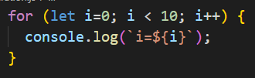
Iteration: for loop
There are 3 basic iterators as there in most languages: for, do and while
A for loop is used to repeat statements a specific number of times so use when you know how many times to repeat
for ([initialization]; [condition]; [statement])statement
The sequence is:
initialise – e.g. let x=0; This happens once only
condition – check if the condition is true and if not, terminate the loop. e.g. x < 5; Otherwise execute the statement or block
on completion of the statement, or all statements in the block, execute the loop-expression
goto 2
Initialise
Condition true?
no
yes
Execute Statements
Execute loop-statement
Exit loop
/demos/basics/for.js
Notes:
Modify the switch example by wrapping a loop around it of 20 to ensure all days are generated at least once

Slide 16
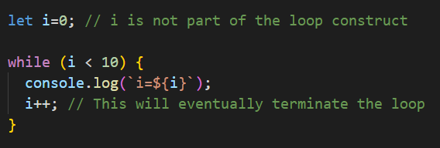
Iteration: while loop
A statement outside the loop will act as an initialiser
A while will test the loop condition at the start so may execute zero times. The code within the loop will be used to terminate the loop
while (expression is true) execute statements
The expression is tested. If it’s false, the loop terminates without executing any of its statements. If true, it will execute all the statements in a block then return and test the expression until it’s false. i.e. something in the loop needs to make the expression become false
An example of a while loop may be reading a file. If the file is empty then do nothing. If it isn’t, keep reading until the end
In the following, if i was already 10, the loop would exit
Condition true?
no
yes
Execute Statements
Your code needs to eventually make the condition false
Exit loop
/demos/basics/while.js

Slide 17
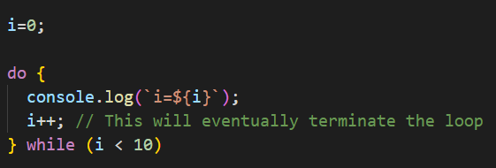
Iteration: do while loop
A statement outside the loop will act as an initialiser
This is essentially the same as the while loop but tests the condition at the end so ALWAYS executes the statements at least once
do { statements } while (expression is true)
So, execute the statements, test the loop-expression and if true, repeat; if false, exit the loop. Like the while loop, something in your code needs to make the loop-expression become false or it will never exit
Execute Statements
Your code needs to eventually make the condition false
Condition true?
yes
no
Exit loop
/demos/basics/do.js
Notes:
Do lab 1 for half an hour or so

Slide 18
Hands-0n exercises
1. Declare a person's first name, e.g. Jimmy. Generate a random number between 1 and 20 inclusive to act as a random age. Output: <name> is <age> years old. e.g. Jimmy is 12 years old. Run the program several times to check the age changes.
2. Copy your solution to 1 into a new file. Modify it such that your program outputs the person's random age ten times.
3. Copy your solution to 2 into a new file and modify it such that: if the generated age is less than 11 then output <name> is <age> so attends infant school. If the age is between 11 and less than 16, output <name> is <age> so is at senior school. If the age is greater than 16 but no greater than 18, output <name> is <age> so at sixth form. If the age is 18 or more, output <name> is an adult Otherwise, output "I've no idea where <name> is now at the age of <age>" If <age> is an odd number output <name> really is at an odd age having reached <age>. Your program should run 20 times. Inspect the output to ensure each path has been visited
/labs/1 sequence selection iteration.docx
Notes:
Stop after each one to discuss what can be improved and why I have done mine as I have
/grad scheme/ hands-on/basics

Slide 19
Functions
A function is an independent piece of code acting as a building block. Functions should be loosely coupled – i.e. it is asked to do one thing, it does it, and that’s it. For example, you may have a program that takes user input, calculates something then outputs the result in some formatted way. You could do this as a single program or as a simple program and 3 functions: getInput, doCalculation and outputResults. A main program would “call” the functions in order to get the job done. The benefit of using functions is that they can be developed and tested independently and concurrently by different team members and can be reused elsewhere. If you need to output results again in the program, you already have a function available so don’t need to develop another. If your function is useful, others may use it in their programs so it promotes reuse. Functions are fundamental to modular programming so you must become very familiar with them
JavaScript functions can become quite complex but the basic use is the same as other languages
A function is a block of code. It has a name. It can optionally have parameters to which arguments are passed. It can optionally evaluate to a result. They are very flexible so there are a number of permutations to consider. The options are:
A function with no parameters and no return value
A function with one or more parameters and no return value
A function with no parameters but a return value
A function with one or more parameters and a return value
Notes:
I'll explain in more detail with examples. I'll call these type 1 - 4
Trace through sequence in debugger

Slide 20
Function declaration (bold text are JavaScript reserved words):
function functionName(optionalParam1, optionalParamN) { statements to be executed return optional result } There are several other function constructs but these in the demo will do for now
/demos/functions/all
/labs/2 basic_functions
Notes:
Go through all of them

Slide 21
Hoisting and scope
A variable declaration consists of a unique name and memory is allocated for it. You can use var, let or const. e.g. var x, const y, let z
All function and var declarations are hoisted to the top of the file so you can declare them after they have been used. Not good practice but it will work
Variable can be initialised during declaration. e.g. var x=3, const y='Tuesday', let z=23.878
Scope means "where is the variable accessible from". Undeclared variables, e.g., x=5 are not hoisted so only exist once the assignment is made and they are automatically given global scope – i.e. no matter where they are declared, they have global scope - i.e. accessible from anywhere in the file. DON'T do this unless there is a justifiable reason to do so. var, let and const have function scope (discussed later). const and let also have block scope, var doesn't. i.e. variables declared with let or const are only available from within the block in which they are declared. This is far safer as they can't inadvertently be modified from code in a different block. e.g. { let x=20 } will be visible to code only within the block {}
let is used for variables you want to allow to be changed whereas const is for variables protected from change
I won't dwell on the detail but discuss it when writing code, just use let and const. Don't use var or undeclared variables
Notes:
More detail here: https://www.digitalocean.com/community/tutorials/understanding-variables-scope-hoisting-in-javascript

Slide 22
Array
An array is a collection of values indexed by position let names=['Linda','Ryan','Tim','Warren','Martin'] Linda is a string at position 0 and Martin is a string at position 4 To access these use: names[0] and names[4]
Unlike strictly typed languages such as C and C++, JavaScript array elements do not need to be the same type: let vals=['Linda', 25, true, 7/3, 'Ryan']
/demos/array_objects/array.js

Slide 23
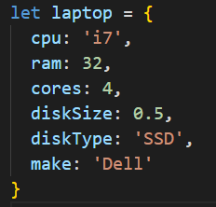
Objects
An object is a variable but is more complex because it too can contain variables and functions. It’s a collection of values like an array but not indexed by position but indexed by name.
Objects tend to represent things – nouns as opposed to functions which represent verbs
Let’s define a person. They are a thing so can be an object with properties such as name, age, eye colour etc. These could all be separate variables but an object allows us to group them as a set of attributes and give the group a name and access them by name
For example, to change the cpu cores of the following object, write laptop.cores=8;
/demos/array_objects/objects.js

Slide 24
Objects with functions
In object orientation, objects are self contained. They know all they need to know about themselves and they can contain methods (functions owned by an object) that enable users of the object to “ask” the object to "do something", and they have attributes holding data where you can ask an object about itself
e.g. a person is an object (noun). Ask a person to jump (verb) and they can do as they know how to do that as it’s built-in to the person. An attribute of a person could be their name, age etc. Ask their name and they can tell you
Class has been introduced into JavaScript to try to better accommodate oop but the idea here is just to show you how objects can store data and do things using methods. oop is not an objective of this phase
Array of objects
You can have an array of anything, including objects
/demos/array_objects/methods.js
/demos/array_objects/array_of_objs.js

Slide 25
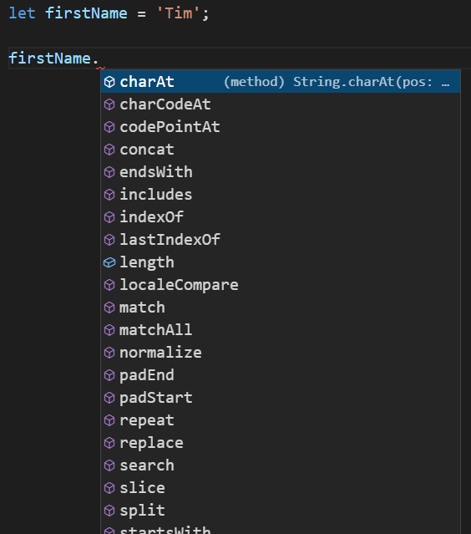
Using common methods on common objects
String A string in JavaScript is in fact an object. When you say let name=‘Tim’, you are in fact creating and initialising an object which has methods This makes life so much simpler for you than in languages like C. Just look at the number of available methods and properties having declared one variable and that isn’t all of them
labs/arrays_and_objects.docx
Notes:
We should now know enough JavaScript to get some basic stuff done.
We will do some more later as needed

